Slide 1
MAKING DATA TALK
Communicating Public Health Data
David E. Nelson, MD, MPH
Harry T. Kwon, PhD, MPH, MCHES
September 5, 2012
R2R Mentorship Program Training Webinar
Notes:
Introduce the book and the background for writing it.
“We wrote this book with two main purposes in mind: (a) to summarize and synthesize research on the selection and presentation of data pertinent to public health, and (b) to provide practical suggestions, based on this research summary and synthesis, on how scientists and other public health practitioners can better communicate data to the public, policy makers, and the press in typical real-world situations.”

Slide 2
Acknowledgments
Division of Cancer Control and Population Sciences
Brad Hesse, PhD
Robert Croyle, PhD
Office of Communications and Education
Madeline La Porta, MS
Alissa Gallagher, MPH

Slide 3
“Why does it matter how health and science
issues are reported? It matters because
misleading information is potentially
dangerous: It can even cost lives.”
– The Royal Institution of Great Britain,
Guidelines on Science and Health
Communication

Slide 4

Think about the worst scientific presentation you’ve ever experienced.
What made it so horrible?

Slide 5
Common Problems
Too much information
Used too much technical language or jargon
Key points not clear
Too much data and poor graphical design, e.g., tables or figures illegible or hard to decipher
Practical application missing

Slide 6
Overview
General considerations
Better ways to visualize data
Practical framework on selecting and presenting data (OPT-In)
Two practical examples demonstrating key points

Slide 7
General Considerations
Notes:
The key lesson is that you can’t understand how to communicate data well without some understanding of communication principles in general.

Slide 8
Contrasts Between Scientists and Lay Audiences
 | Scientists | Lay Audiences
Level of Interest in Health Topic | High | Medium/Low
Science and Mathematical Literacy | High | Low
Acceptance of Uncertainty | High | Low
Definition of Acceptable Evidence | Narrow | Broad
Belief in Rational Decision Making | Strong | Variable
Ability and Interest in Reviewing Extensive Amounts of Data | High | Low

Slide 9
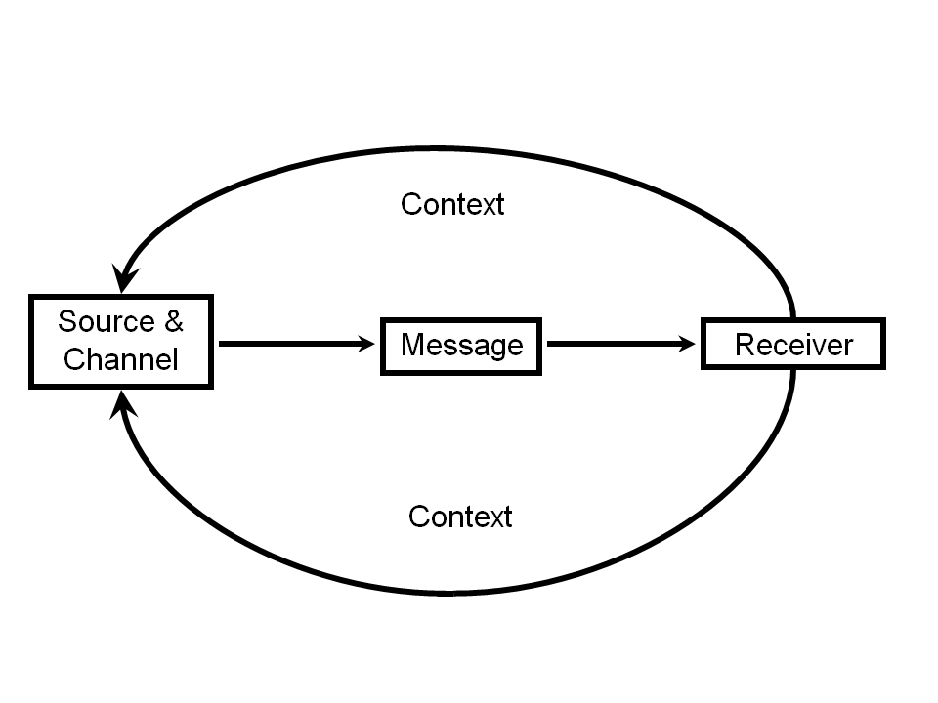
Basic Communication Model
“Meaning is not transmitted by experts as much as it is constructed by audiences”*
*Lum et al. “General public: Communicating to inform,” Communicating Public Health Information Effectively: A Guide for Practitioners
(Two-way, not one-way, communication)
Notes:
Before discussing approaches on communicating data to lay audiences, it is essential to understand the fundamentals of communication.
In the basic communication model, a source (or sender) uses a channel (or channels) to send messages to an audience (or audiences). Sources are generally the individuals or organizations that supply messages and they generally select the channels through which they attempt to reach audiences with those messages.
Note that the curved lines with arrows directly connecting audiences to sources and channels show that audiences are active participants in the entire communication process, capable of seeking information themselves.
Three additional components are important considerations in the basic communication model: purpose, strategy, and context.
We are concerned today with selecting and communicating quantitative data in messages lay audiences can understand.

Slide 10
Storylines that are Science-Based
Main Point: What is core, or “bottom line” information, you want to convey? This is your storyline and everything in your messages keys off it. Storylines differ for:
Settled Science
Ex: Fluoridating public water supplies reduces the risk of dental carries.
Unsettled Science
Ex: PSA Testing
Notes:
Science-based storylines, that is, the major conclusions that communicators would like audiences to understand, form the foundation on which messages are developed.
Science-based storylines vary widely, depending on the type of research and level of consensus among scientists. The strongest types of storylines are based on comprehensive reviews of the scientific evidence. The easiest storylines are based on “settled science.” Other science-based storylines are not so clear-cut. The purposes for communicating messages to lay audiences, in these instances, will be increase knowledge or for informed decision making.

Slide 11
Four Purposes for Presenting Data
Increase knowledge
Instruct
Facilitate informed decision-making
Persuade
Notes:
These are the four purposes for communicating data to lay audiences
To effectively communicate quantitative information, a storyline is needed.

Slide 12
Major Types of Lay Audiences
General Public
Policy Makers
Media Representatives

Slide 13
Audience Factors Influencing Communication About Health
General level of interest in health
Involvement with a specific health issue
Demographics
General public/societal health beliefs and worldviews
Social networks and culture
Structural factors
Occupational and institutional factors
Confirmation bias and selective exposure

Slide 14

Low Scientific Literacy of Lay Audiences
Definition:
“The public understanding of
scientific principles and basic facts”
e.g., less than half know antibiotics do not kill viruses

Slide 15
Why Use Data (Numbers) in Messages?
Data provide supportive information: a form of evidence that leads to conclusions or recommendations:
Dominant form of evidence used in scientific fields
Increases source credibility
Can increase lay audiences’ knowledge, be more persuasive, assist with decision making
But remember: fewer data are usually better due to cognitive processing limits and low math literacy

Slide 16
Why Use Data (Numbers) in Messages? [cont’d]
Relying on the “numbers to speak for themselves” is wishful thinking
Data can enhance source credibility and increase the believability of messages
Keep in mind that people expect health experts to describe:
What is going on
What it means
What needs to be done about it
Notes:
There are certain situations and audiences for which presenting data is not recommended, such as when the purpose for communication is instruction. But data have been shown to be influential in many instances with lay audiences (p 61)
There is consistent research from the persuasion and related literatures showing that sources who use evidence, including statistical evidence, to support their claims are rated by audiences as having higher credibility.
Lay audiences expect health experts to describe what is going on, what it means, and what needs to b done about it (e.g. personal actions by members of the public, funding decisions) (p 99)
It is not as easy as simply “showing audiences data, and hoping that the numbers will speak for themselves.”
The main reason to communicate data is because audiences want to know the reasons why individuals or policy makers should believe or do what scientists recommend.

Slide 17
Seven Roles for Data in Messages
Raise awareness
Reduce levels of concern
Explanation (cause-and-effect)
Provide contextual information (e.g., comparisons)
Predict
Evaluate
Maintain awareness

Slide 18
Values & Ethics
What data [can substitute “information”] you present…
What data you omit…
How you present data…
Who you present data to…
When you present data
Answers to ALL these questions have important ethical considerations and reflect values

Slide 19
Examples on How Data Can be Used for Advocacy as Part of a Theme
Gloom (things are bad)
“1 in 8 women in the U.S. will develop breast cancer in their lifetime.”
Control and Hope (solution for a problem, e.g., a new program, policy, etc.)
“We believe there would be a 50% reduction in the number of bicycle-related head injuries if a mandatory bicycle helmet law is enacted.”
Success
“The colorectal cancer screening program resulted in a doubling of the number of people screened.”
Notes:
Gloom examples in context of raising awareness:
1 in 8 women in US will develop breast cancer in their lifetime
3,000 kids a day start smoking in the US
2,000 sick children each month in area X are turned away from health clinics because of lack of medical staff
Control and Hope examples in context of prediction:
“1000 more people each year in Health District C would receive dental care because of this program.”
“We believe there would be a 50% reduction in the number of bicycle-related head injuries if a mandatory bicycle helmet law is enacted.”
“2000 lives a year would be saved in this state if funding is provided for a health education campaign to increase immunization among infants.”
Success example:
“The X program resulted in a doubling of the number of women screened”

Slide 20
When Does Planning for Data Presentation Occur?
Purpose for communication determined
Audience characteristics assessed
Contextual factors acknowledged
Storyline identified
Should data be used? Not always a good idea…

Slide 21
Presenting Data
3 Tools of Scientific Communication:
Words
Numbers
Symbols (Visual)
Overall purpose in designing presentations is to support the audience in building knowledge
enhance understanding
limit interpretation errors

Slide 22
Words, Numbers, and Symbols
“Communicating with the public in surveys or other forms, is a matter of creating the right balance between words, numbers and symbols.”
-Don A. Dillman (paraphrased)
Notes:
In 2005, the NCI invited survey methodologist Don Dillman to speak at a conference on methodological issues in communication science. He emphasized that effective communication between scientists and the public, whether in collecting data through surveys or communicating data back to audiences, must strike an appropriate balance in the use of words, numbers, and symbols.

Slide 23
Words and Numbers
Explicitly or implicitly use one or two numbers lay audiences can readily understand.
“There are more than 45 million uninsured persons in the U.S.”
“The prevalence of childhood obesity has more than tripled over the previous two decades in this country.”
“Diabetes is now the leading cause of renal failure.”
Notes:
Effective communicators weave words, numbers, and symbols together to create cohesive messages
Words:
Words can be used to help communicate a storyline about the numbers
Can add context and meaning to statistics
Ex: amount of alcohol consumed on a college campus in one year is the same as the volume of an Olympic sized swimming pool
Words can be used to help communicate a storyline instead of numbers
To be used when the presentation of actual data is not advisable (e.g. working with audiences who have low quantitative literacy, persons with narrative orientation who prefer not to be presented with data, or under instruction/authoritarian settings
Verbal Qualifiers
Use words to describe the relationship between numbers (e.g. much higher, minimal risk, most of the time)
They are less cognitively demanding than numbers and they fit in with peoples tendencies to process data for the overall gist of the argument
But substitution for actual numeric values can create situations: e.g. low or minimal risk may be interpreted as no risk

Slide 24
Use Data Comparisons to Help Provide Context
“There has been a 300% increase in hospital-acquired infections over the past 20 years (time trends)”
“Colorectal cancer is the 2nd leading cause of cancer deaths among men (ranking)

Slide 25
Metaphors and Narratives
Metaphor: a phrase implying “A is like B,” i.e., a comparison/similarity between the two; use no more than one, and best if heard
Narrative: use of words, visual images, or both to tell a story (data can be integrated)
Notes:
Metaphors
Makes it possible to understand concept A by bringing in the meaning and feelings associated with concept B
Especially useful in helping public health communicators establish a personalized connection with an audience
Most likely to be effective if:
The audience has some familiarity with the comparison item
The comparison item has a higher level of novelty
They are used early in a message
If they are presented in an audio format
Narratives
Use of words, visual images or both to tell a story that is fictional or nonfictional
Compared to metaphors, narratives are generally longer
Practical reasons to use:
Some people have a narrative orientation and prefer to receive information in story format (know your audience).
Some people have difficulty understanding other data presentation formats.
They can increase understanding and persuasiveness in ways not possible through other data presentation formats.
They can evoke emotions.

Slide 26
Metaphor Examples
“There are 10 times as many gun dealers in California as there are McDonald’s restaurants”
“Only 3% of Canadians would prefer a U.S.-type private health insurance model to the single payer model. To put that in perspective, 16% of Canadians believe that Elvis Presley is still alive”
Source: Wallack, LM. News for a Change: An Advocate’s Guide to Working with the Media. Sage, 1999

Slide 27
Narrative Example
The Cost of Oral Rehydration Therapy
So this…woman calls up and said she has a 9-month-old baby with diarrhea and the doctor on call gave her the right advice, said go to the pharmacy and buy Pedialyte®…but when she got there, they said they couldn’t give it to her
for free without a prescription.
… The kid appears in the emergency room 36 hr later and dies three days later…The rehydration solution costs up to $6.30 a liter. It’s obscene charging this much for a product that ought to be cheaper than Coca-Cola—it has less in it.
Source: Wallack et al, 1993

Slide 28
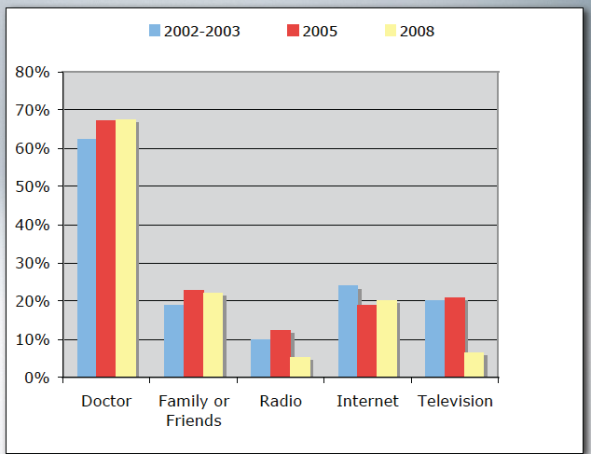
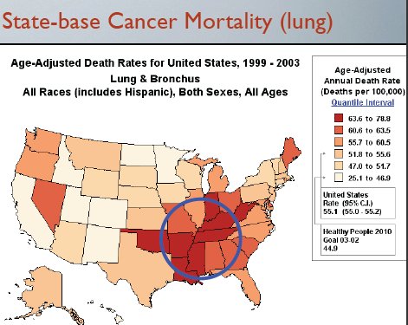
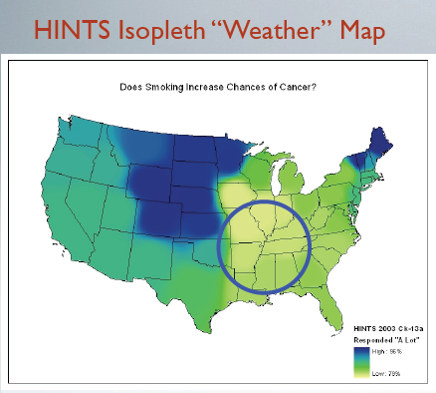
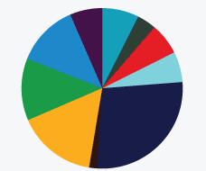
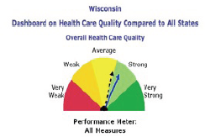
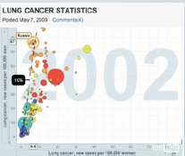
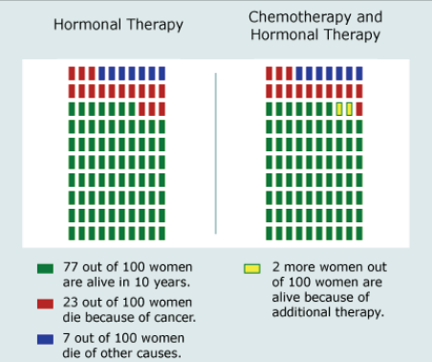
Visual Presentations
Notes:
Visual presentations can help demonstrate magnitude, highlight changes, and make comparisons
The goal of visual data presentation [for advocacy] is to highlight aspects that support the desired role and theme (e.g. to demonstrate cause and effect or support a gloom theme) p. 291.
Pie charts, bar charts, line graphs, and maps are the four visual modalities likely to be most helpful with advocacy

Slide 29
General Suggestions for Visual Data Presentations
Carefully tailor data visual displays for audiences’ scientific and mathematical ability
Make data available in formats more understandable to lay audiences
Provide locally relevant data and comparisons (e.g., to other areas when possible)
Explicitly state key messages using short text messages, e.g., “Oral rehydration therapy greatly reduced infant deaths”

Slide 30
Pie Charts
Show proportions/percentages
Begin with largest slice pointed at 12 o’clock position
Display slices clockwise and descending order
Add short labels
Avoid using more than 6 slices

Slide 31
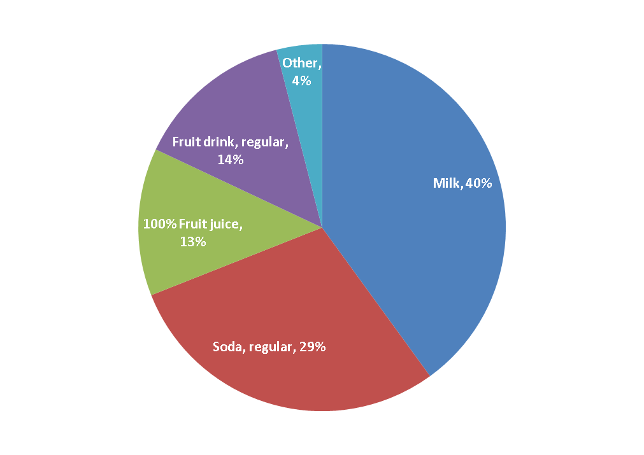

Pie Charts
Notes:
Pie Charts
Can be helpful for visually demonstrating magnitude—when the communication objective involves the largest or smallest pie slice (e.g. a small slice could be used to show the limited funding that a particular program receives relative to other programs)
Describe/discuss pie chart example

Slide 32
Bar Charts
Good for displaying magnitude of data values
Use 6 or fewer bars if possible
Use color/shading with strong contrast
Use short titles, labels, messages
Try not to use segmented/stacked bar charts or overlay line representations on top of bars

Slide 33
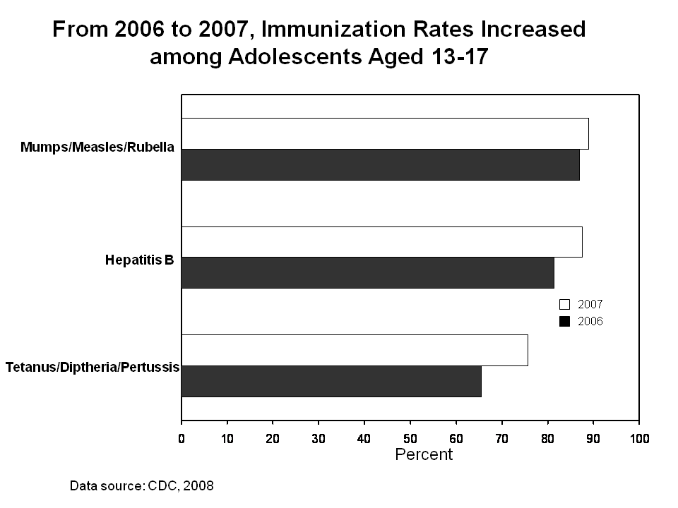
Bar Charts
Notes:
Bar Charts
Can be most helpful for visualizing magnitude (e.g. # of individuals affected, relative risk, percentage change
Can be used to raise awareness, demonstrate cause and effect, show evaluation findings, or maintain relationships
Use as few bars as possible to minimize cognitive burden and delineate magnitude from largest to smallest
Describe/discuss bar chart example

Slide 34
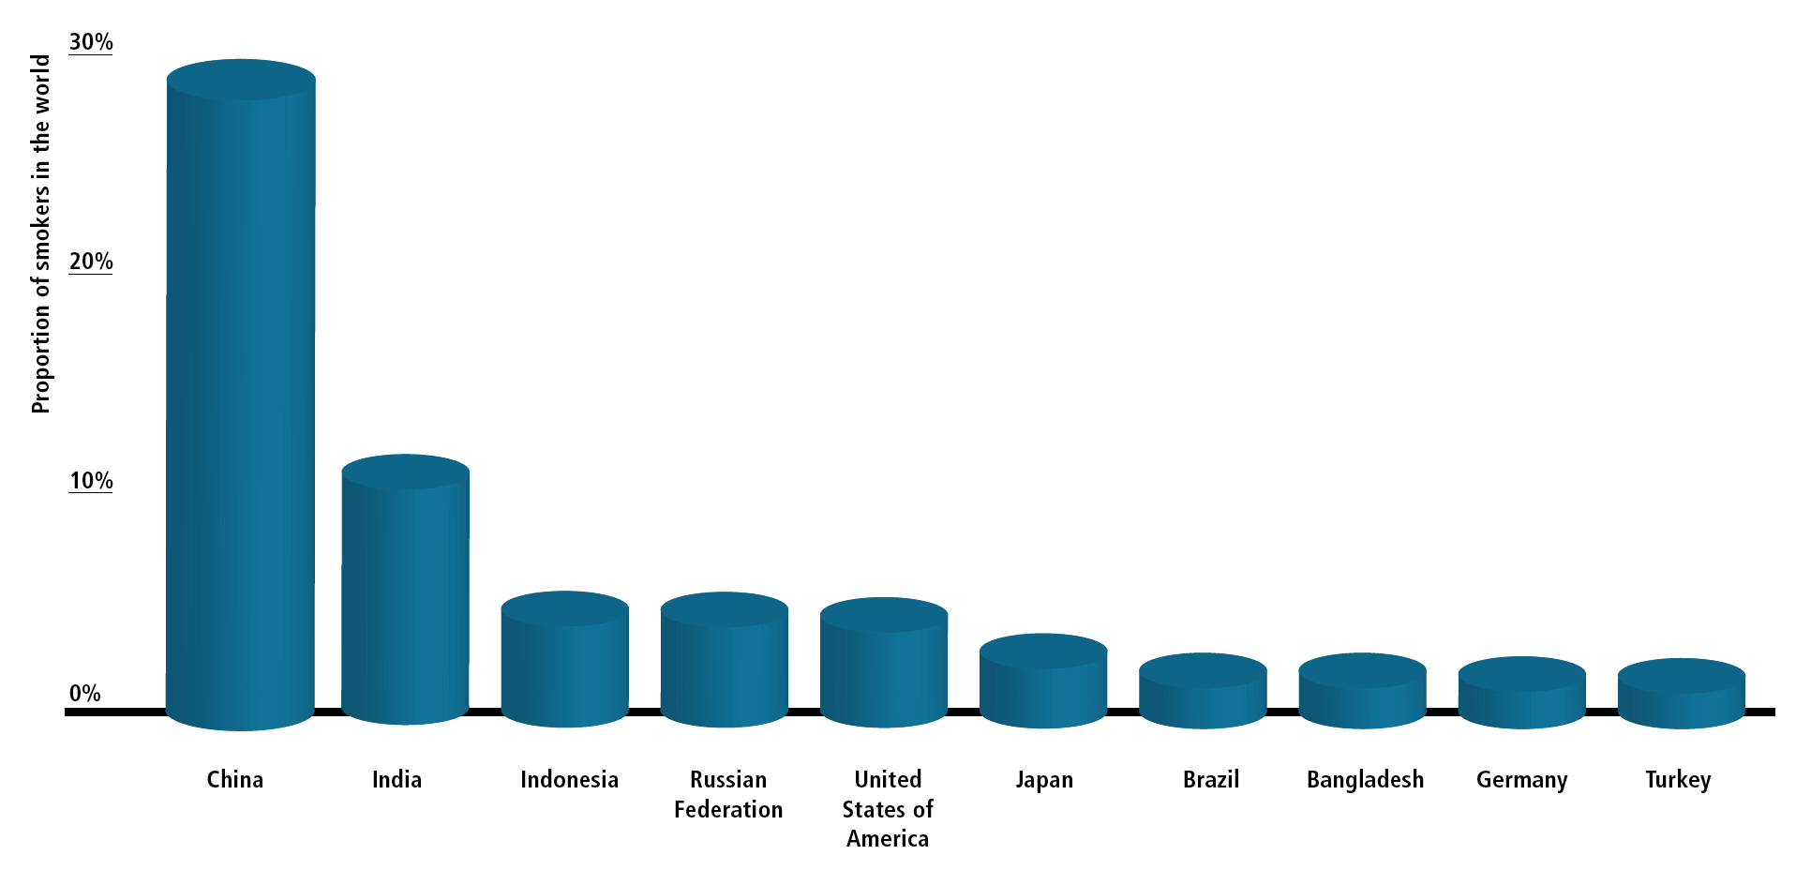
Nearly 2/3 of the World’s Smokers Live in Just 10 Countries
More than 40% live in just 2 countries
Notes:
34

Slide 35
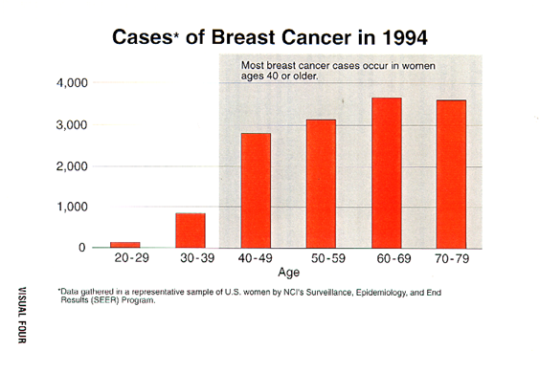

Slide 36
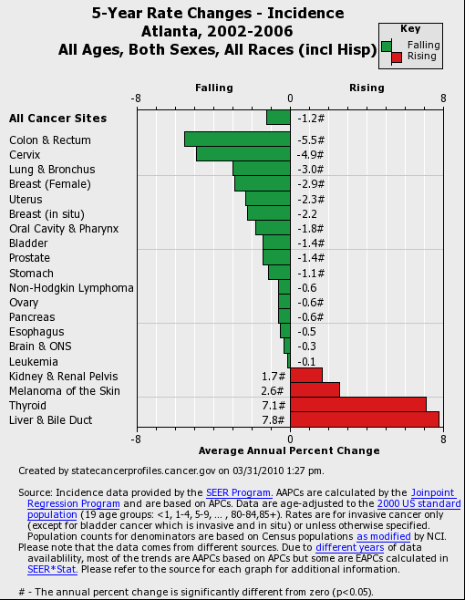
Bar Charts
Notes:
Describe/discuss bar chart example
Using data from state cancer profiles, this chart displays the 5-year cancer incidence rate by cancer type from 2002-2006 in the Atlanta metropolitan region.

Slide 37
Line Graphs
Great for showing trends over time, before and after differences, and contextual information
Use arrows/text to highlight key data/events
Place labels close to their lines
Include baseline data line for comparison
Try to limit up to 4 trend lines and not to add unnecessary labels and symbols

Slide 38
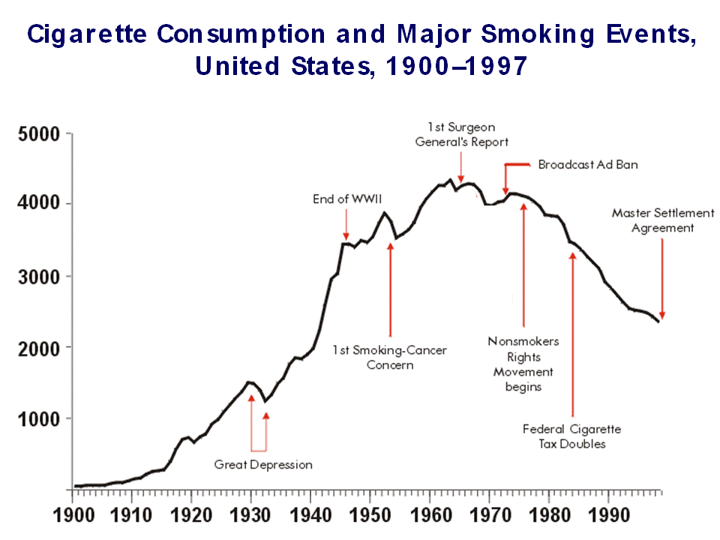
Line Graphs
Notes:
Line graphs
Most versatile visual modality for advocacy—they can present data for all the roles (raise awareness, cause and effect, predict, evaluate, maintain awareness) and themes (gloom, control and hope, success).
Can visually demonstrate things that are getting better, worse, or not changing by showing trends over time
Describe/discuss line graph example

Slide 39
Line Graphs
Cigarette Smoking among U.S. Adults, 1955-2009

Slide 40
Visual Scales
Can help in presenting risk (probability) data and absolute risk data
Use where numbers are ordered and there are equal distances between intervals
Use familiar scales (e.g. thermometer, dash board meters, etc.)
Provide anchoring information
Include short titles and key messages
Don’t include too much information

Slide 41
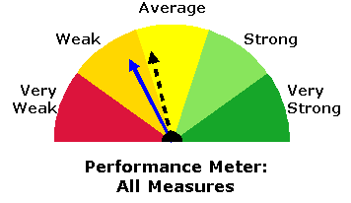
Visual Scales
Provides a way to present a lot of data in more engaging and effective ways
Example: AHRQ
State Snapshot
of New Mexico
Notes:
Visual scales
Another way to visually present data and can be used to visually represent risk data
May be used to present interval (equal distances) or ordinal (ranking/Likert) data
Like pie and bar charts, graphs, scales also have an added benefit of being familiar (e.g. thermometer representations, color scales (e.g. security threat scale).
Example scale is from AHRQ State Snapshots—this one is for New Mexico (dash line is baseline, solid line is most recent data year)

Slide 42
Common Problems When Presenting Data Using Visual Aids
Clutter: too much data and other information
Being inconsistent with layouts
Visual distractions (e.g. too many colors,
3-dimensional bars, audiovisual “extras”)
Distortion, especially y-axis for bar charts or line graphs

Slide 43
Before
Data Source: Youth Risk Behavior Surveillance — United States, 2011, MMWR, 61, 1-162

Slide 44
After
Data Source: Youth Risk Behavior Surveillance — United States, 2011, MMWR, 61, 1-162

Slide 45
Other Examples
Kaiser Family Foundation and American Medical Association Health Policy Visualization
Medicaid example:
http://jama.jamanetwork.com/article.aspx?articleid=1352118
HIV/AIDS example:
http://jama.jamanetwork.com/article.aspx?articleid=1221707

Slide 46
General Notes
Keep it simple and clear
Carefully tailor visual displays for audiences’ scientific and mathematical ability
Focus more on what you want your audience to understand and help people build knowledge around the issues being communicated

Slide 47
OPT-IN
A practical framework on how to present data (and other scientific information) to lay audiences
Notes:
Organize
What is the scientific story?
What functions will data serve?
Plan
Audiences, messages, channels?
Timeline?
Test
User-centered design
Translational research
Integrate
Connect with partners
Connect the dots for users

Slide 48
OPT-IN
Organize
What is the scientific story?
What functions will data serve?
Plan
Audiences, messages, channels?
Timeline?
Test
User-centered design
Translational research
INtegrate
Connect service w/ partners
Connect the dots for users
OPT IN
Notes:
Okay, up this point we have emphasized that “data do not speak for themselves.” Communicating data is a communication process, and like any communication process attention must be given to improve outcomes. We also feel that now is the time for data to enter the mix to inform crucial decisions regarding health. As director of the NIH Francis Collins said, “The NIH has an obligation to provide the credible data upon which important societal discussions can play out.”
We also know that to “not communicate” is to communicate. The purpose of this book is to get all of us to “opt back in” to the conversation in making data talk in credible and ethical ways.
To guide the reader’s thinking, and to summarize the main points in the book, we developed a simple framework we called OPT-In.
Opt-In stands for Organize, Plan, Test, and Integrate.
Organize
What is the scientific story?
What functions will data serve?
Plan
Audiences, messages, channels?
Timeline?
Test
User-centered design
Translational research
Integrate
Connect with partners
Connect the dots for users

Slide 49
Organize
1) What does the science tell us?
2) What is the level of consensus for the findings?
3) What are your possible storylines?
4) Will it be helpful to use data to communicate your message/storyline? If yes, why?
5) What role are the data playing?
6) Why were the data collected?
7) What are the limitations of the data?

Slide 50
Plan
1) Why are you communicating findings?
2) What is known about your audience?
3) What is the current communication context?
4) What are your preliminary functional messages?
5) What strategy will you use?

Slide 51
Test
1) How will you identify and recruit potential candidates to informally and formally test messages,
materials, and channels?
2) Exactly how will you test your messages?

Slide 52
Integrate
1) How will you synchronize your messaging across communication channels and over time?
2) What other resources will you provide to your audiences?
3) What will you do to help your audience understand the data within a broader context?
4) How will you make clear what the audience can or should do with the data?

Slide 53
Example 1: Why Testing Messages Matters
Colorectal cancer mortality rates high among African American men
Planning for community health promotion effort to increase colorectal cancer screening among AA men
Messages and frames tested among community members

Slide 54
Three Potential Frames
Impact: AAs have a high rate, thousands die from CRC each year, 2nd only to lung cancer
Progress: AAs making great strides as death rates are decreasing. Much of this improvement because of increased screening
Disparity: AAs more likely to die from CRC than whites mainly because they are less likely to be tested

Slide 55
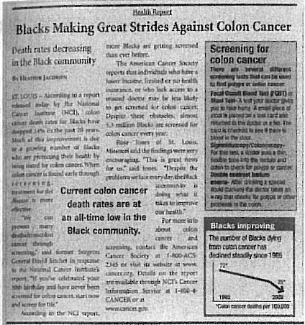
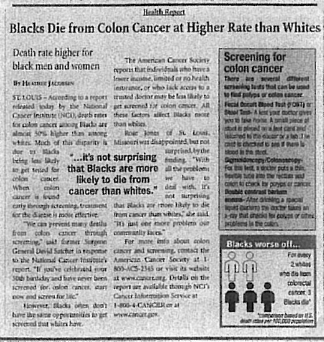
Figures with progress & disparity newspaper headlines
Source: Making Data Talk, p. 191, Figure 5.2

Slide 56
Example 2: Helping Public with Information Seeking for Antidepressants on the Internet
Consumers Union sponsors Consumer Reports Best Buy Drugs (CRBBD)—web site and reports
Credible organization (high trust and no conflicts of interest), useful content for audiences, and information can be found rapidly (well-designed)
Organize: a) no one storyline; b) drug effectiveness based on reviews by OHSU; c) cost data from a national monitoring service (Walters Klower Health)

Slide 57
Example 2 (cont’d): Plan and Integrate
CU considered what is a best buy for audiences: a) top tier of effectiveness; b) good safety record; c) low average price. Web content/ crucial!
Data need to be used; their role: raise awareness
Integration involved consistent messages across all communication products (45-s and 10-min videos, 3 types of written reports)
Integration example: summary of recommendations & bulleted text, top 3 recommended drugs in reports

Slide 58
Consumer Reports Drug Web site Figure
Source: Consumers Union, 2009

Slide 59
Conclusions
Communication is a complex process; there is no “one best way” to communicate data
Knowing and understanding audiences are crucial
Remember the principles of communication and purpose for data; avoid style over substance
Present no more data than necessary
Notes:
so, don’t take it for granted.

Slide 60

Making Data Talk: A Workbook
www.cancer.gov/MDT-Workbook.pdf

